Slide 1
Recommendations on Meta Quest 3 Vasukumar Patel
Computer Engineering Technology - Computing Science Algonquin College
January 22nd,2024
ENL2019T 309

Slide 2
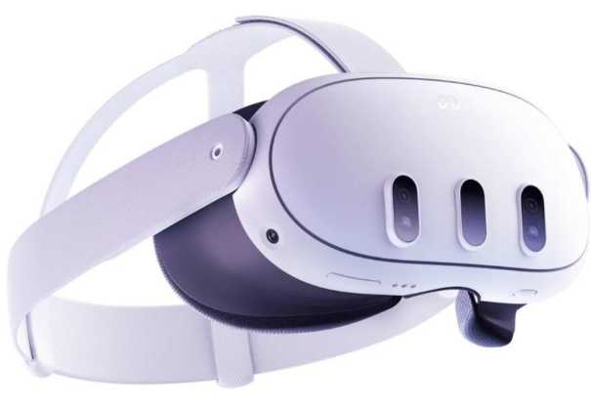
4.0 Results and Discussion (Criteria vs. Solution)
4.1 Fast Charging of Meta Quest 3
The goal is to ensure rapid charging, finishing in under 3 hours.
The battery information for the Meta Quest 3 is sourced from the Meta website, which offers precise technical specifications for hardware developed by Meta Corporation.
According to Meta, the Meta Quest 3 can be fully charged in about 2.3 hours [2].
This passes the criterion for fast charging.
The Meta Quest 3 comes with super fast charging. (see Figure 2).
Figure 2: Meta Quest 3 with super-fast charging [2]

Slide 3
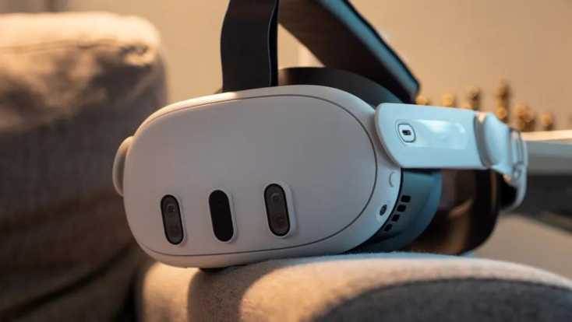
4.2 Cost of Meta Quest 3
The goal is to manufacture the Meta Quest 3 for under $500.00, including a complimentary repair service.
The manufacturing cost details for the Meta Quest 3 are taken from Android Central, which offers reliable information on the hardware costs developed by Meta Corporation.
Android Central reports that the manufacturing cost of the Meta Quest 3 is under $500.00 [3].
This passes the criterion for cost.
The Meta Quest 3 comes with affordable cost. (see Figure 3).
Figure 3: Meta Quest 3 with affordable cost [3]

Slide 4
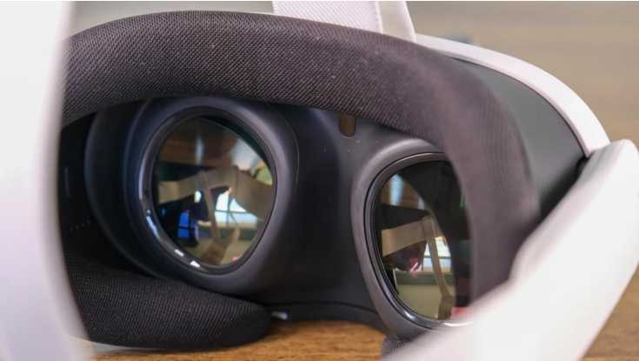
4.3 Visual Quality of Meta Quest 3
The goal is to utilize a mini-LED display to enhance visual clarity, providing more vibrant colors and improved contrast.
The mini-LED information for the Meta Quest 3 is sourced from BGR, which provides dependable details about the mini-LED technology used by Meta Corporation in the Meta Quest 3.
BGR states that the Meta Quest 3 can utilize mini-LED technology to enhance visual quality [4].
This passes the criterion for visual quality.
The Meta Quest 3 comes with high visual quality. (see Figure 4).
Figure 4: Meta Quest 3 with high visual quality [4]

Slide 5
5.0 Conclusion
Battery life and charging, cost, and display & visual quality are the main three criteria to evaluate Meta Quest 3. These criteria demonstrate that it meets all requirements. The device supports superfast charging. It charges fully in 2.5 hours. In addition, it costs just $500.00, making it a budget-friendly option. The device has mini-LED technology, which ensures enhanced visual clarity, offering an improved user experience. Due to this, the Meta Quest 3 is a suitable and cost-effective solution for gaming and education. This report supports the adoption of Meta Quest 3 as a viable option for users seeking high performance at an affordable price.
All criteria for the Meta Quest 3 were passed (See Table 1).
Table 1: Meta Quest 3 Recommendation Criteria
Criteria | Pass | Fail
Battery life and charging | x
Cost | x
Display & Visual Quality | x

Slide 6
6.0 Recommendation
Due to the battery life and charging cost and display & visual quality provided, Meta Quest 3 is recommended.

Slide 7
References
[1] B. Ashworth, "The Leaked Quest 3 Headset Video Teases Meta's VR Ambitions," wired.com, 23 August 2023. [Online]. Available: https://www.wired.com/story/meta-quest-3-headset-video-leak/. [Accessed 11 February 2025].
[2] Meta, "Meta Quest 3," Meta, [Online]. Available: https://www.meta.com/ca/quest/quest-3/. [Accessed 31 January 2025].
[3] N. Sutrich, "This is how much the Meta Quest 3 really costs to make," Android Central, 21 November 2023. [Online]. Available: https://www.androidcentral.com/gaming/virtual-reality/meta-quest-3-manufacturing-cost?utm source=chatgpt.com. [Accessed 31 January 2025].
[4] C. d. Looper, "Meta Quest 3 review: The best VR headset... for now," BGR, 15 November 2023. [Online]. Available: https://bgr.com/reviews/meta-quest-3-review/. [Accessed 31 January 2025].

